Slide 1
XGames: Congo Java the Hutt
By Jacob Augustine, Tyler Dansby, Nick Kaliher, Tejaswini Kancharla, and Josh Welch

Slide 2
Agenda
Brief overview of Congo
Sprint Artifacts
Meetings
Progress
Design Choices
Refactoring
Review and Retrospective
Demo
Questions

Slide 3
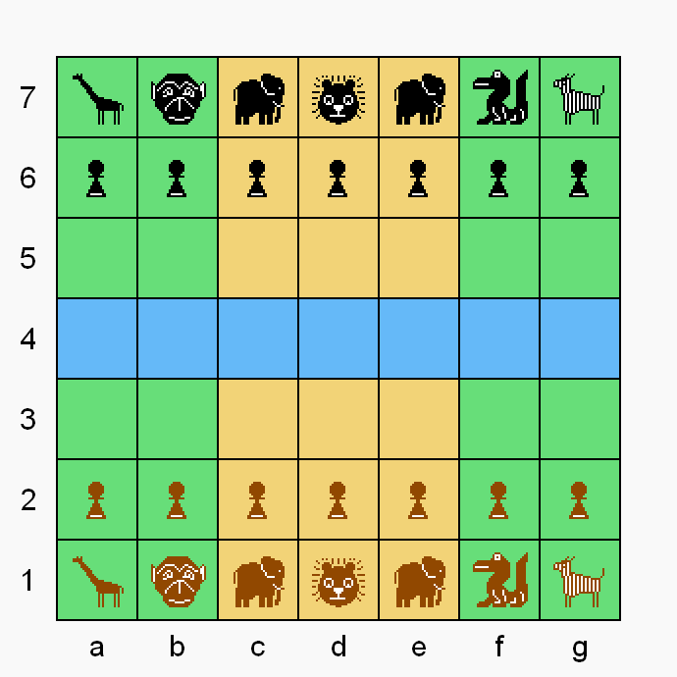
Congo
A player wins when they capture the opponent’s lion, or the the opponent only has their lion left.

Slide 4
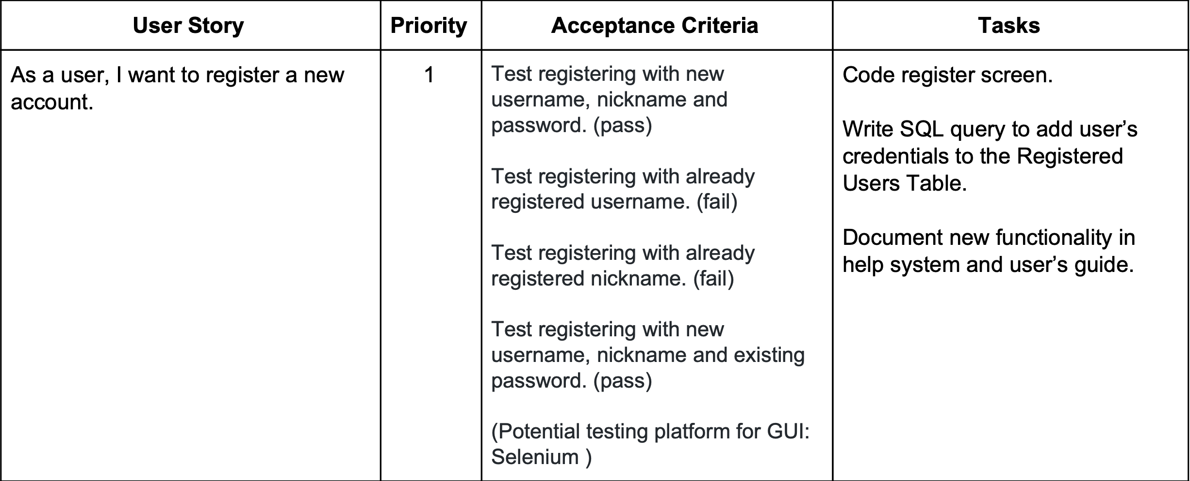
User Stories

Slide 5
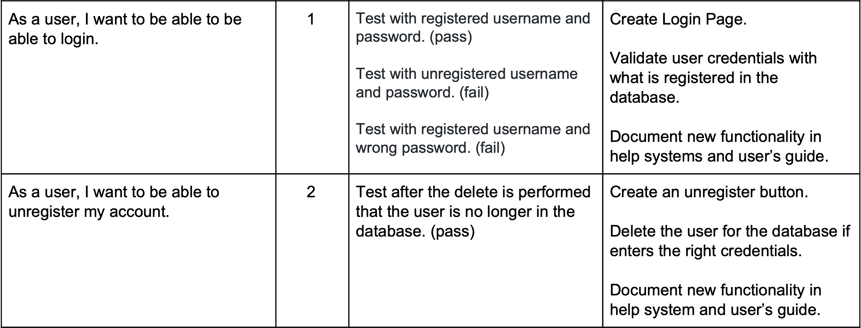
User Stories Continued…

Slide 6
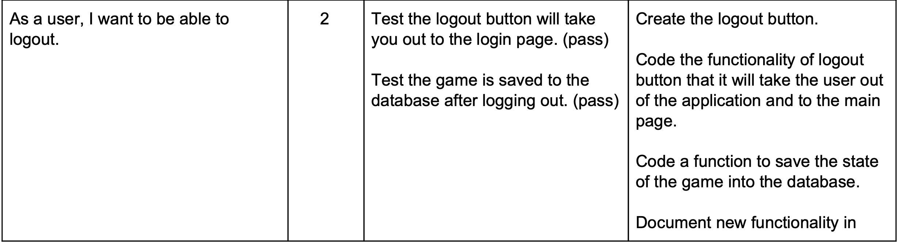
User Stories Continued…

Slide 7
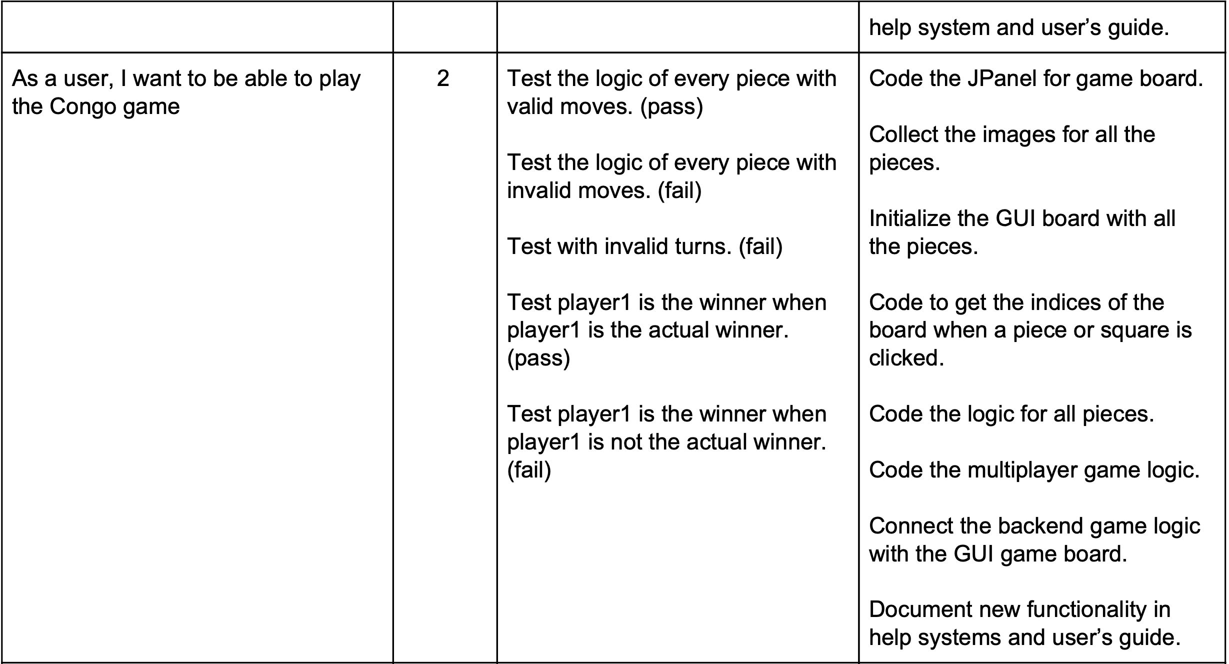
User Stories Continued…

Slide 8
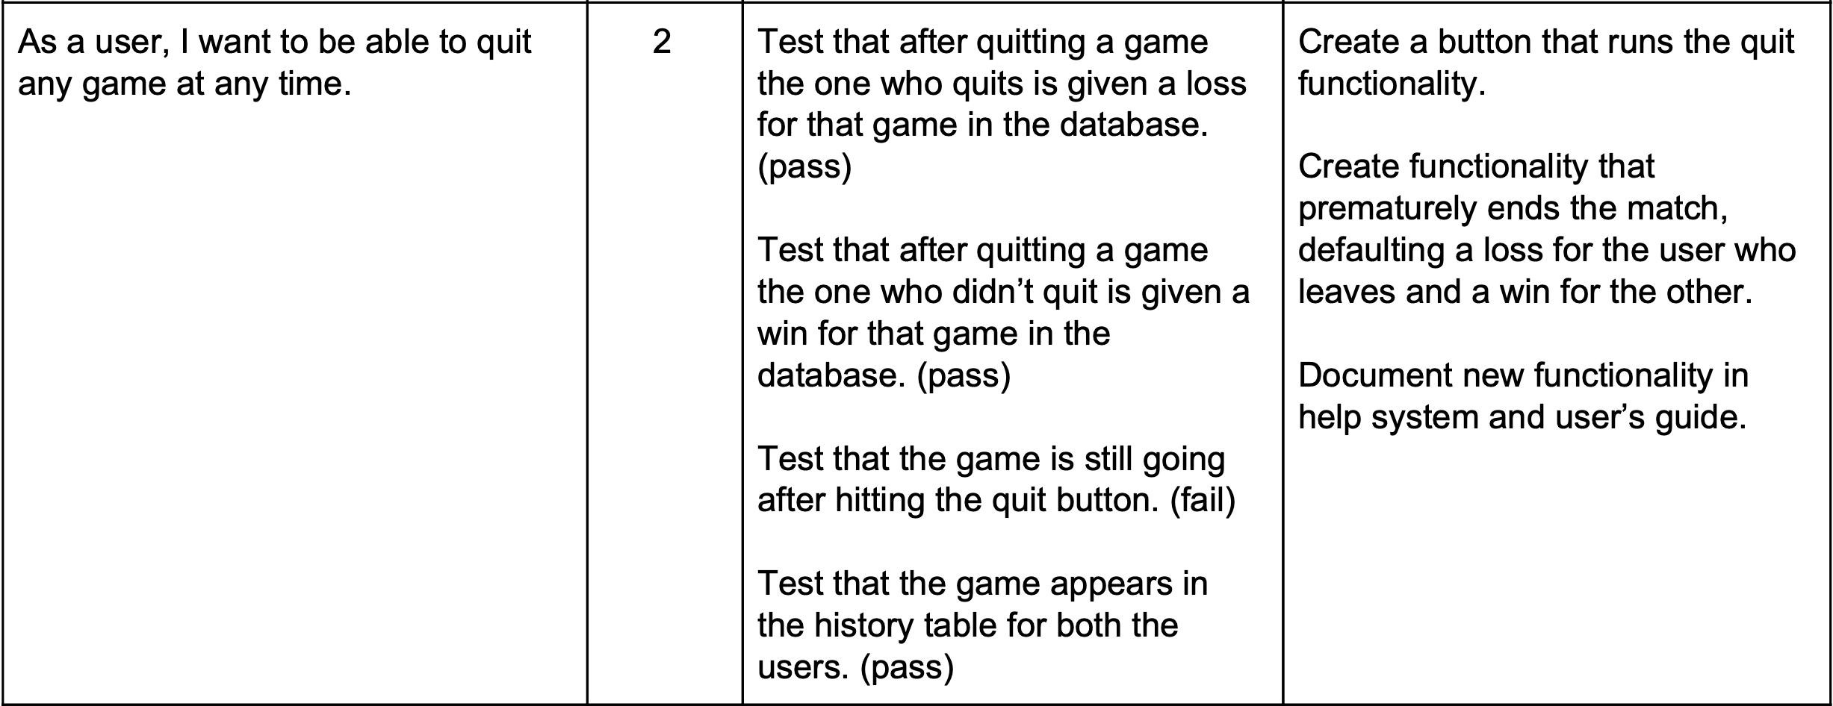
User Stories Continued…

Slide 9
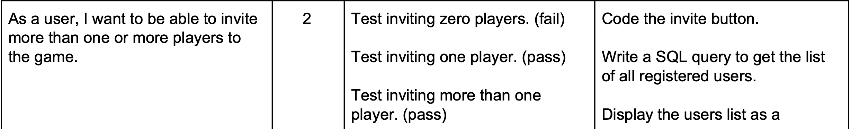
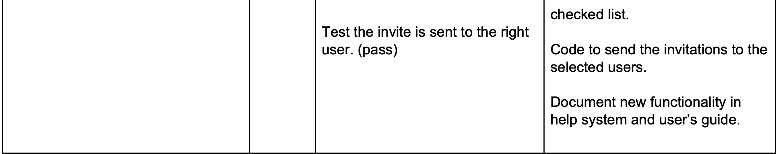
User Stores Continued...

Slide 10
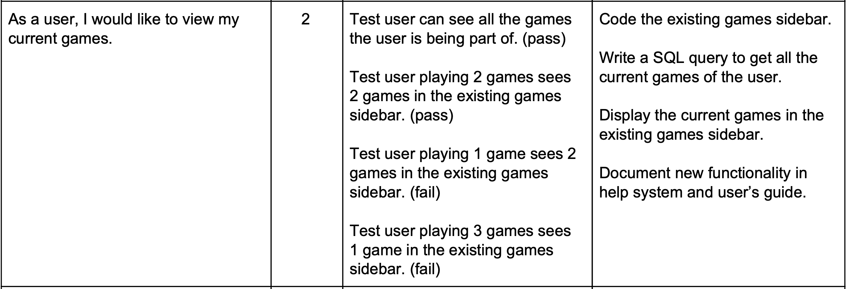
User Stores Continued...

Slide 11
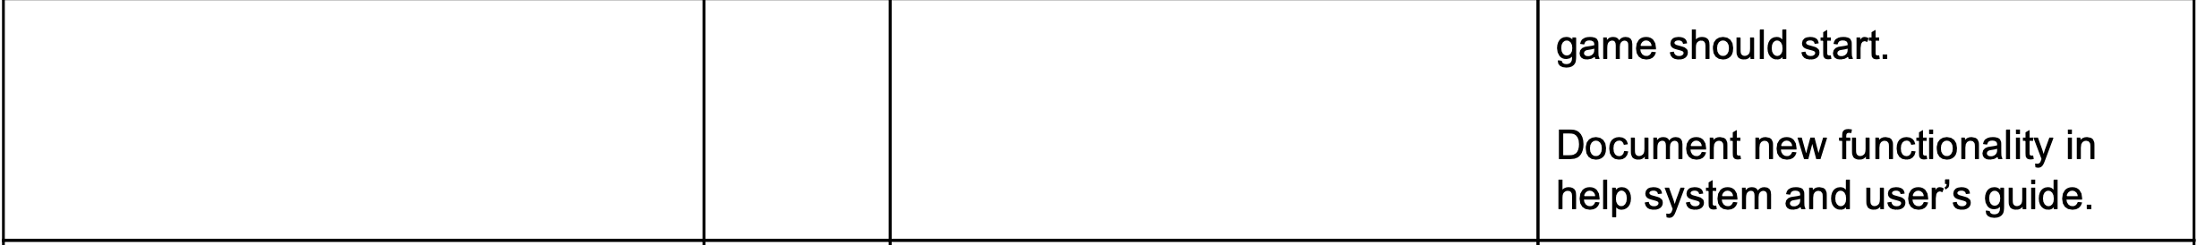
User Stores Continued...

Slide 12
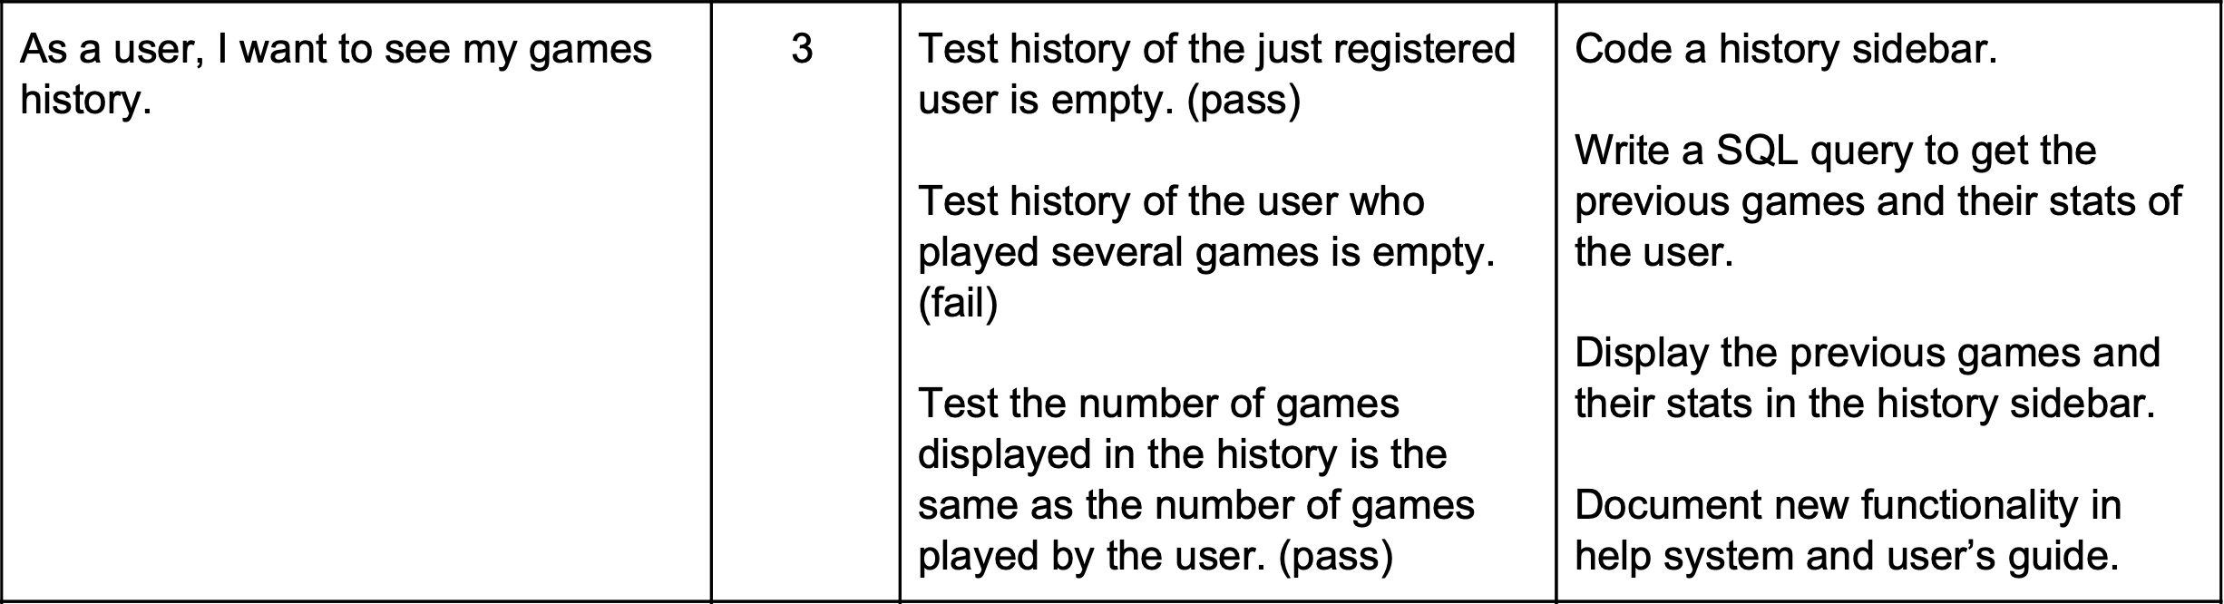
User Stores Continued...

Slide 13
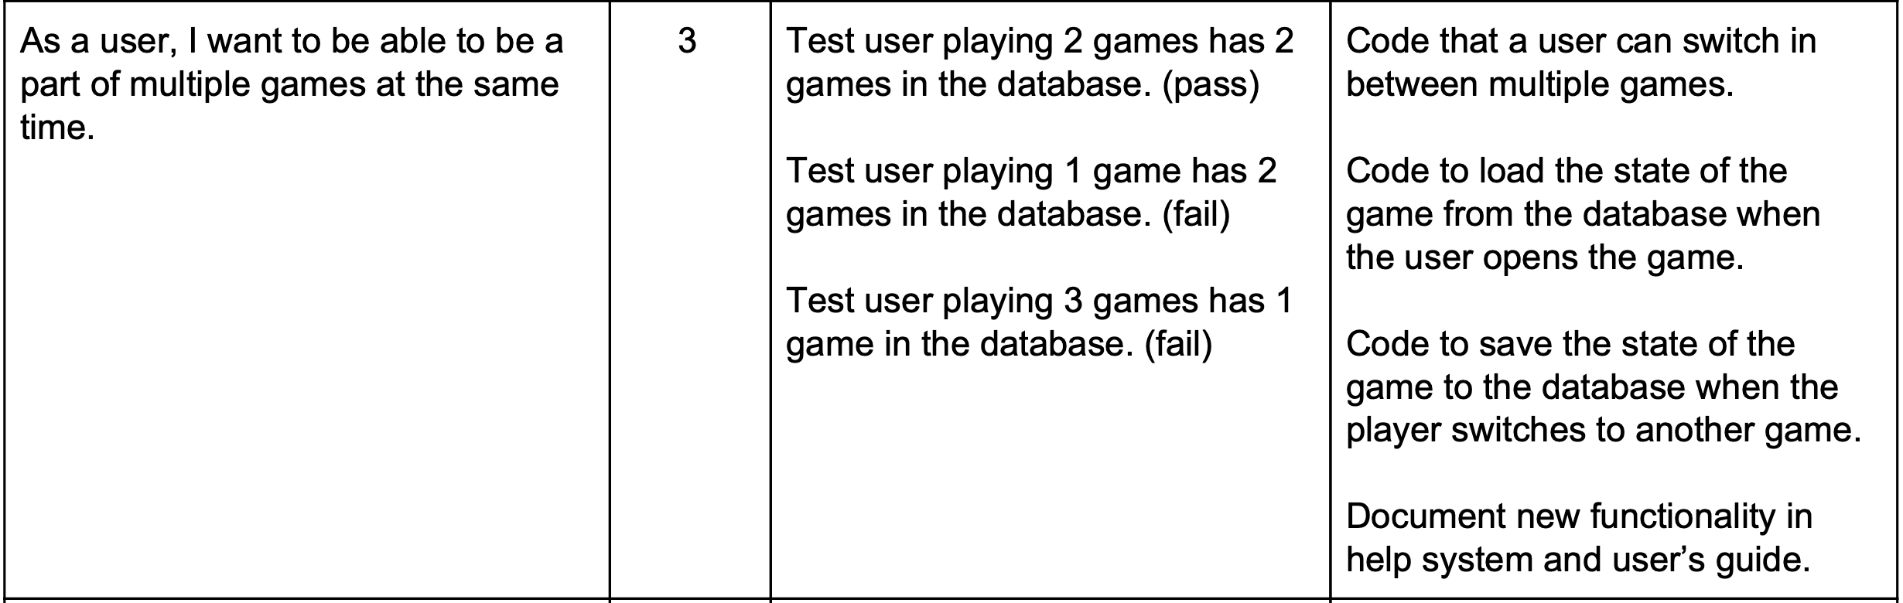
User Stores Continued...

Slide 14
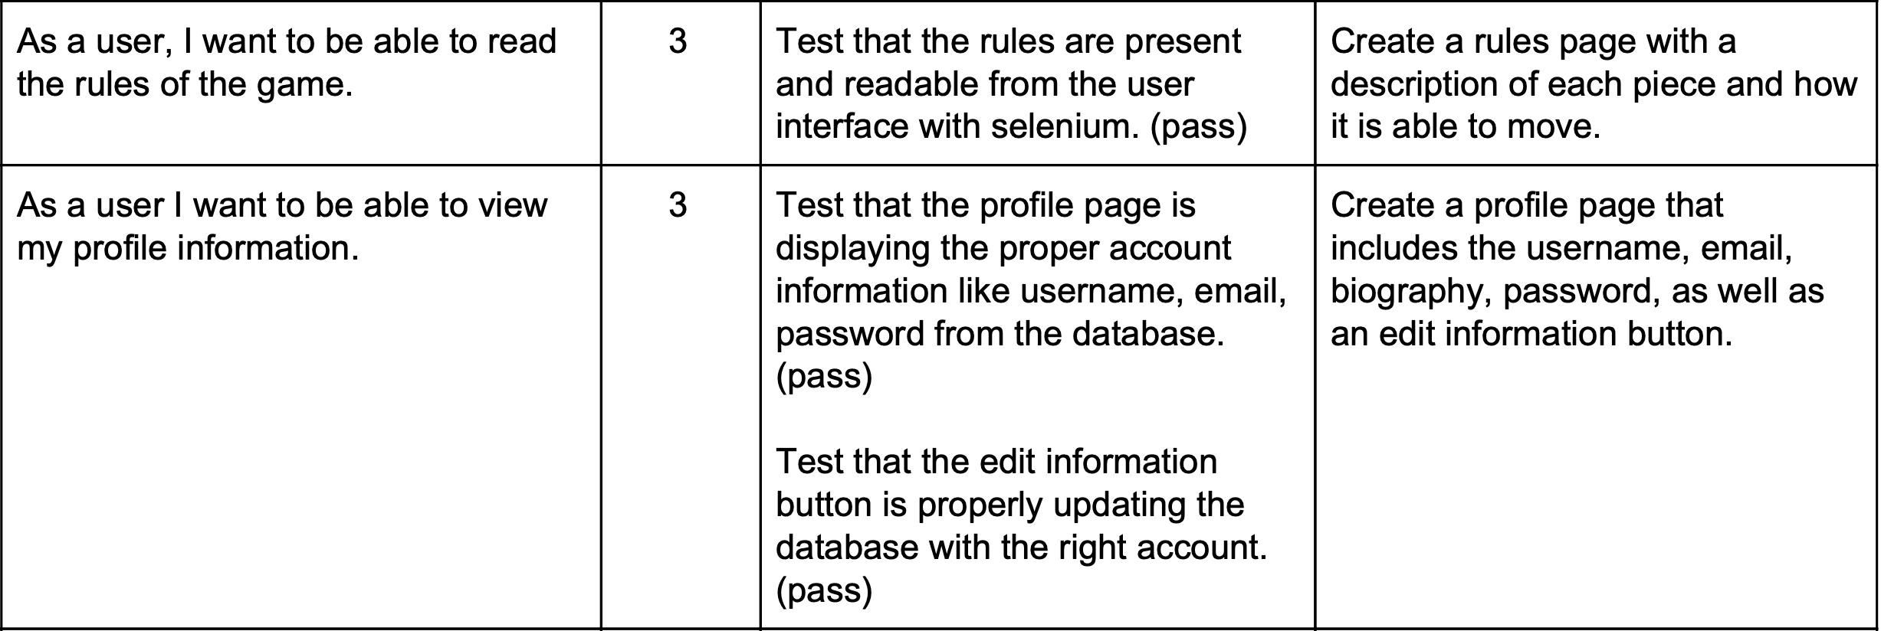
User Stores Continued...

Slide 15
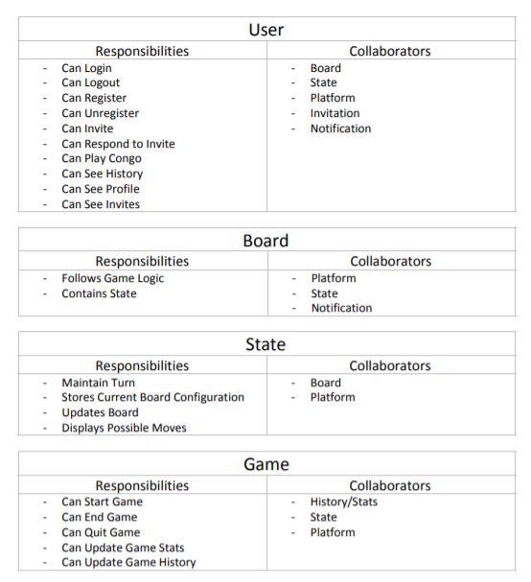
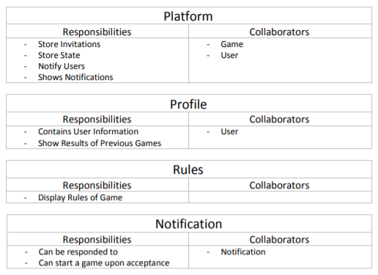
CRC Cards

Slide 16
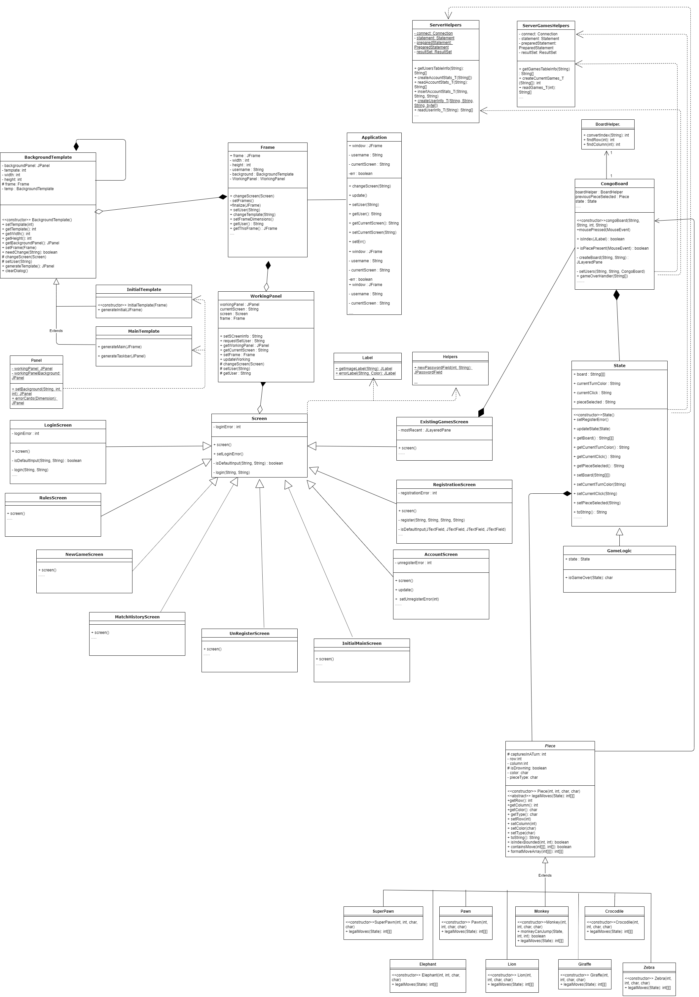
Class Diagram

Slide 17
Meetings
Meeting 1
Discuss Refactor of GUI and Logic (and Tests)
Start Refactor
Meeting 2
Begin Existing Games Sidebar
Continue Refactor
Meeting 3
Start rules page, continue working on existing games
Finish up refactoring logic, start refactoring tests
Continue Refactoring GUI
Meeting 4
Continue Refactoring tests and GUI
Meeting 5
Finish GUI refactor
Start invites
Sprint Review with Product Owner
Showed off login/register
Showed Multiplayer
Went relatively well
Meeting 6
Finish up invites/multiplayer
Finish test refactor
General Cleaning
Retrospective

Slide 18
Refactor Process
GUI Changes
Logic Changes

Slide 19
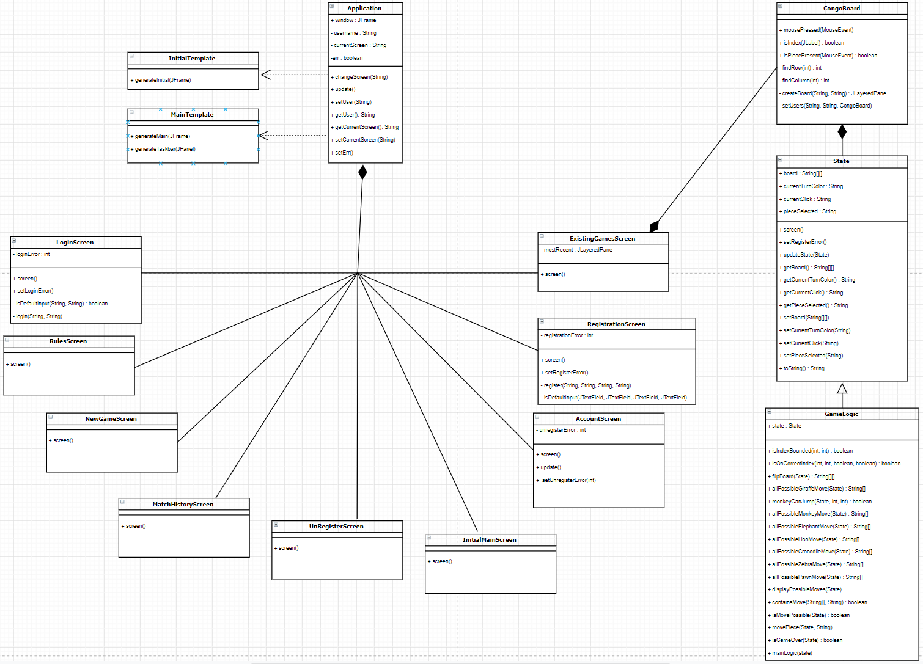
Class Diagram Changes With Refactor

Slide 20
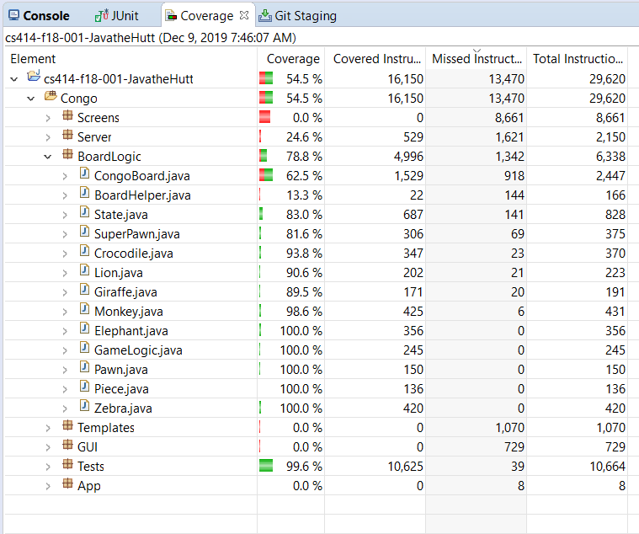
Test Coverage

Slide 21
Progress
Completely Done:
Game Logic
Login/Register/Unregister
Multiplayer
Rules Page
Partially Done:
Account Page: Uploading Picture, Changing username and email
Constant Refresh/Multi-threading
Undo Button for moves
Invites only create upon creation, not time based, can’t decline

Slide 22
Design Decisions and After Thoughts
Java Swing Library Easy to set up, tough to maintain/develop
Raspberry pi is good, but slightly slow
Kept simple with DB and Pi (without React and Web Server)
Eclipse JUnit Coverage worked well

Slide 23
Review and Retrospective
Sprint Review with Product Owner
Sprint Retrospective
Overall Morale
Decision Choices
Future Improvements

Slide 24
DEMO

Slide 25
Questions?

